Slide 1
Programming with B4X
Lesson 18 – Complex Data Types & Views
Anywhere Software
March 2021

Slide 2
Today you will learn
Type declaration
Arrays of Type
List of Type
Map of Type
KVS Files
CustomListView
B4XComboBox

Slide 3

The type statement
How many Students can we declare like that?
Private LastName1, FirstName1, Address1, PhoneNumber1 As String
Private LastName2, FirstName2, Address2, PhoneNumber2 As String
Private LastName3, FirstName3, Address3, PhoneNumber3 As String
Private LastName4, FirstName4, Address4, PhoneNumber4 As String
When we have more than 1 or 2 students, then we have trouble…
Notes:
Often a developer wants to group variables related to each other. For example, a student has a First Name, Last Name, Address, Phone, etc. It can of course create separate variables for each different element of the student but it is more convenient to create a new data type that contains all these values together.

Slide 4
Type declaration
Sub Class_Globals
Type Student(LastName As String, FirstName As String, _ Address As String, PhoneNumber As String)
End Sub
Type declaration is always Public and declared into Class_Globals of B4XMainPage
Notes:
The described data type is called type and is stated as follows
Notice that the keyword “Type” is first written, then a name is written for the new variable that is created, and finally in parentheses all variables included in the new type. Type declaration is always written in Class_Globals and it is Public.

Slide 5
Variables of Type
Sub Class_Globals
Type Student(LastName As String, FirstName As String, _ Address As String, PhoneNumber As String)
Private Student1 As Student
Private Student2 As Student
End Sub
Student1.LastName = “Ioannidis”
Student1.FirstName = “Alkinoos”
Student1.Address = “Athens, Greece”
Student1.PhoneNumber = "+303465854234”
Student2 = Student1
Notes:
The “Student1” variable is now a Student-type variable, and to access its data you use the variable name with one period and then the name of the items included in the type statement e.g.
You can create as many variables of the Student type as you want and assign each other

Slide 6

Show Items
Log(Student1)
Log(Student1.LastName & “ “ & Student1.FirstName)
LogStudent(Student1)
Private Sub LogStudent(st As Student)
Log(st.FirstName)
Log(st.LastName)
Log(st.Address)
Log(st.PhoneNumber)
End Sub
Notes:
To display or use all elements of a type, use the entire name along with the item.
Log(Student1. LastName & “ “ & Student1.FirstName)
It is usually helpful to create a routine that accepts a type variable and then displays or processes the type elements.

Slide 7
Table of a type
Sub Class_Globals
Type Student(LastName As String, FirstName As String, _
Address As String, PhoneNumber As String)
Public Students(10) As Student
End Sub
Students(0).LastName = “Paul”
Students(0).FirstName = “Belmond”
Notes:
You can also create tables of Type where it will include more students.
The Student(10) statement creates a table of 10 Students. Each item can be used with a for loop or with a separate reference to each with its index.

Slide 8
List of Type
Sub Class_Globals
Type Student(LastName As String, FirstName As String, _
Address As String, PhoneNumber As String)
Private listStudents As List
End Sub
Private Sub B4XPage_Created (Root1 As B4XView)
listStudents.Initialize
listStudents.Add(Student1) ‘ Add Student to list
‘Get list items and log
For i = 0 To listStudents.Size-1
Private st As Student
st = listStudents.Get(i)
LogStudent(st)
Next
End Sub
Private Sub LogStudent(st As Student)
Log(st.FirstName)
Log(st.LastName)
Log(st.Address)
Log(st.PhoneNumber)
End Sub
Notes:
A list can contain variables of Type

Slide 9
Maps of Type
Sub Class_Globals
Type Student(id As String, LastName As String, _
FirstName As String, Address As String, PhoneNumber As String)
Public mapStudents As Map
End Sub
Private Sub B4XPage_Created (Root1 As B4XView)
Private Student1 As Student
Student1.ID = "FXA47345S3"
Student1.LastName = "Ioannidis"
Student1.FirstName = "Alkinoos"
Student1.Address = "Athens, Greece"
Student1.PhoneNumber = "+303465854234"
mapStudents.Initialize
mapStudents.Put(Student1.ID, Student1)
End Sub
Notes:
Using map to store type data is also possible as long as you have a unique key for each type variable you enter.
In the case of Students it could be for example an ID number, a registration number, an email account, etc. In this way it is now easy to find a student with a key ID number by calling the Get method.

Slide 10
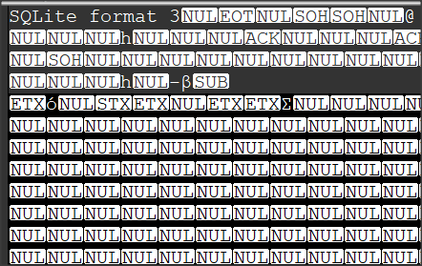
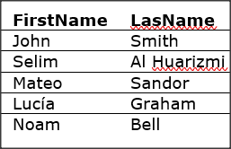
Key Value Store Files (KVS)
KVS File
Plain File
We can read data
with any editor
It is a database file
It is not readable outside
of program
Notes:
The files discussed in Chapter 17 refer to text files that often do not serve to store complex structures such as type declarations, Lists, and Maps. Another type of files supported by B4J is key value store (KVS) files.
The way they work is similar to that of maps. All you need is a key and the structure you want to save. KVS files essentially hide a database, but the important thing is that the developer doesn't need to know any of them as long as he uses the appropriate methods.

Slide 11
Declare a KVS file
Private kvsFile As KeyValueStore
File.MakeDir(File.DirTemp, "lesson18")
kvsFile.Initialize(File.DirTemp&"lesson18","kvsData.dat")
Log(File. DirTemp & "lesson18")
Remember to use the KeyValueStore library
Notes:
To declare a KVS file, you must use the KeyValueStore library to which you click in the library tab.
Then create a KeyValueStore variable.
The above commands create a folder named lesson18 within the temp folder, create a file named "kvsData.dat” and finally display the path of the file on the Log screen.

Slide 12
Insert items into a KVS file
kvsFile.Put(Student1.ID, Student1)
kvsFile.PutMapAsync(mapStudents)
Notes:
The Put method is used to import the data into a KVS file. Each insertion that is made is called Record. A prerequisite is that you have decided on a unique key so that you can refer to the record later. The following example Insert the Student1 variable with the student's ID number as a key.
This way you can write any data type such as Lists, Maps, Strings, simple variables (numbers), types, and tables (only tables from bytes or objects), as well as combinations (one list of maps for example).
Maps can also be stored using the PutMapAsync method. It is also the best way to save map since it enters the map key as the key of the record.

Slide 13

Retrieving items from a KVS file
Student3 = kvsFile.Get("FS23534X21")
LogStudent(Student3)
If the key does not exist, then there is a problem with the operation of the program. The existence of the record must be checked before you assign it to a variable. This can be done with ContainsKey method.
Notes:
The Get method retrieves an item from a KVS file. The returned value is an object. In other words, be careful to assign the returned value to a variable of the same type.
The following example reads from a KVS file the record of a Student.
The value "FS23534X21" is the key to the record and the Routine LogStudent has described previous where accepts a Student and displays with command Log its contents

Slide 14
Read an entire map
Log("Show keys")
Private keys As List = kvsFile.ListKeys
For i = 0 To keys.Size-1
Log(keys.Get(i))
Next
Private mapSt As Map
mapSt = kvsFile.GetMapAsync(keys)
Notes:
You can read an entire map using the GetMapAsync method. This com-mand accepts a list of keys as a parameter and returns a map with the keys and their corresponding values.

Slide 15
Check the existence of a record
If kvsFile.ContainsKey("FS23534X21") Then
Student3 = kvsFile.Get("FS23534X21")
Else
Log("Wrong id key")
End If

Slide 16
Delete KVS file content
kvsFile.Remove("FS23534X21")
kvsFile.DeleteAll

Slide 17
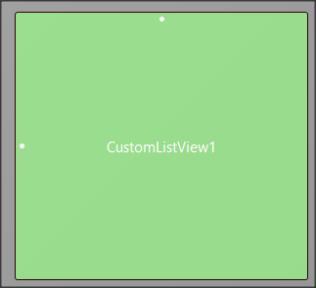
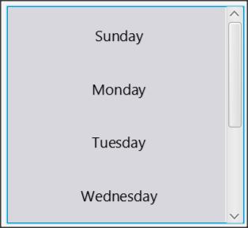
CustomListView
Notes:
Creates a list of items that you can select by clicking the mouse. The returned value is a value that you specified at the time ListView was created.

Slide 18
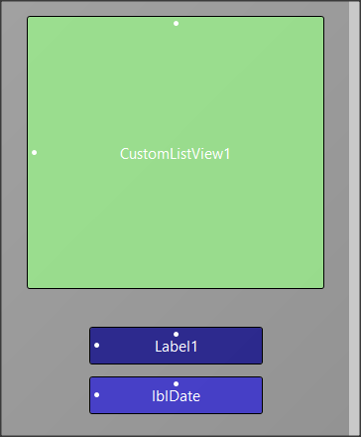
Working with Custom List View – Step 1
Sub Class_Globals
Private Root As B4XView
Private xui As XUI
Private lstItems As List
Private CustomListView1 As CustomListView
Private lblDate As Label
End Sub
Declare a CustomListView variable

Slide 19
Working with Custom List View – Step 2
lstItems.Initialize
lstItems.AddAll(Array As String("Sunday", "Monday", "Tuesday", _
"Wednesday", "Thursday", "Friday", "Saturday"))
Create a list structure that contains the items that will appear in CustomListView

Slide 20
Working with Custom List View – Step 3
For i = 0 To lstItems.Size-1
CustomListView1.AddTextItem(lstItems.Get(i),i)
Next
Scan the entire list and each item is placed in CustomListView1 using the AddTextItem method.
AddTextItem accepts a value that will display and an index that corresponds to the value you want to display.
Notes:
The above example corresponds to the values from 0 to 6 for the days from Sunday to Saturday.

Slide 21
Working with Custom List View
Private Sub CustomListView1_ItemClick(Index As Int, Value As Object)
lblDate.Text = Value
End Sub
When an item in the list is clicked, the _ItemClick event triggered. The example shows the index of the item that was clicked on the lblDatetag.

Slide 22
Additional methods of CustomListView
Clear As String
Deletes all CustomListView components
GetValue (Index As Int) As Object
Returns the value for the index value specified in the parenthesis.
Size As Int [read only]
Returns the number of items.

Slide 23

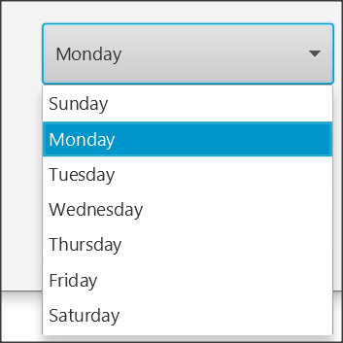
B4XComboBox
Notes:
B4XComboBox displays a drop-down list of items. The user can click one of them and select it. Unlike CustomListView, the returned value is always a number for the order in which the item is placed in The ComboBox, so the developer must then be able to map the value to a structure.

Slide 24
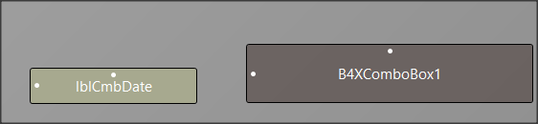
Working with B4XComboBox – Step 1
Sub Class_Globals
Private Root As B4XView
Private xui As XUI
Private lstItems As List
Private B4XComboBox1 As B4XComboBox
Private lblCmbDate As Label
End Sub
Declare a type B4XComboBox variable

Slide 25
Working with B4XComboBox – Step 2
lstItems.Initialize
lstItems.AddAll(Array As String("Sunday", "Monday", _
"Tuesday", "Wednesday", "Thursday", "Friday", _ "Saturday"))
Create a list structure that contains the items that will appear in B4XComboBox

Slide 26
Working with B4XComboBox – Step 3
B4XComboBox1.SetItems(lstItems)
Place the items in the list in B4XComboBox.
Caution does not require iterative structure as in CustomListView

Slide 27
Working with B4XComboBox – Step 4
Private Sub B4XComboBox1_SelectedIndexChanged(Index As Int)
lblCmbDate.Text = Index
End Sub
If an item is selected, the _SelectedIndexChanged event is triggered and returns the index of the selected item.

Slide 28

Thank you!!!
Images:
Photo by Christina Rumpf on Unsplash

